Slide 1
SIMATS ENGINEERING
SIMATS
CSA0812 - Python Programming for Web Application
MINI PROJECT - JAN 2024
INSTITUTE MANAGEMENT PORTAL
(USING PYTHON)
Presented by:
1.Karthik G
2.Navadeep G
3.Ramchand P
Guided by:
Dr Senthil kumar
Faculty Name

Slide 2
Institute Management Portal
Here is where your presentation begins

Slide 3
Abstract
This project work automates INSTITUTE management system. In the system two applications are developed, Windows based (thick client) and Web based (thin client).
The windows application takes most of the activities such as offline student registering, transcript and report card generation and producing the timetable.
In the high INSTITUTE considered for the project there are ten subjects for both grade nine and grade ten.
.

Slide 4
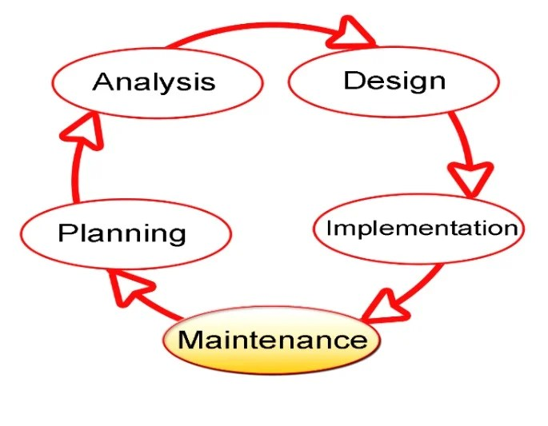
Architecture/Algorithm

Slide 5
Modules
Hear are the institute management system project potential modules . To start the project development , you have to know first the modules that should exist in a INSTITUTE management system.
Each of the modules was based on the activities in INSTITUTE they will be automated to reduce the task of faculties and staff . Here is the list of modules for the INSTITUTE management system project .

Slide 6
Module - 1
Student Information

Slide 7
Student information:
A student information management system is a data management software that helps educational institutions digitize and efficiently manage student information.
A student information system is a web based platform that helps INSTITUTE take student data online for easier management and better clarity.

Slide 8
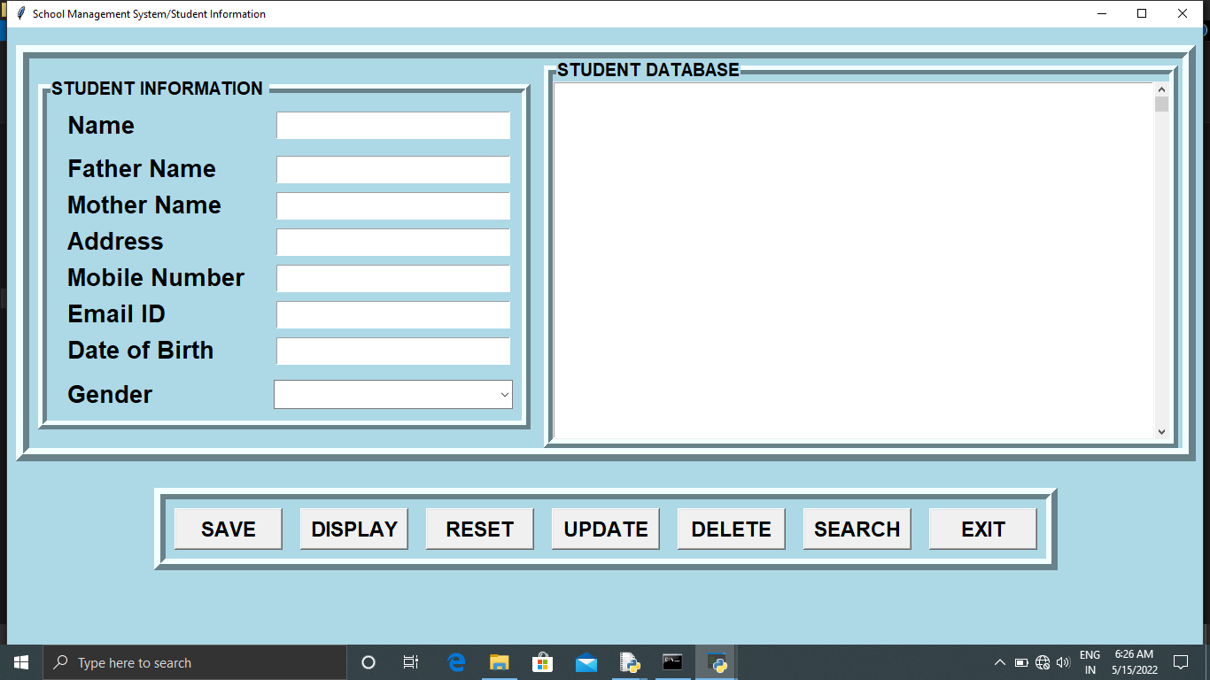
OUTPUT

Slide 9
Module - 2
Fees report

Slide 10
Fees Report:
A fee collection is a payment period during which fees defined by the institution is collected from students.
A fee management software is a task management system that automates fee collection and receipt generation.
It also automates entries into the INSTITUTE accounts that help in reducing errors and eliminating duplicate data entries.

Slide 11
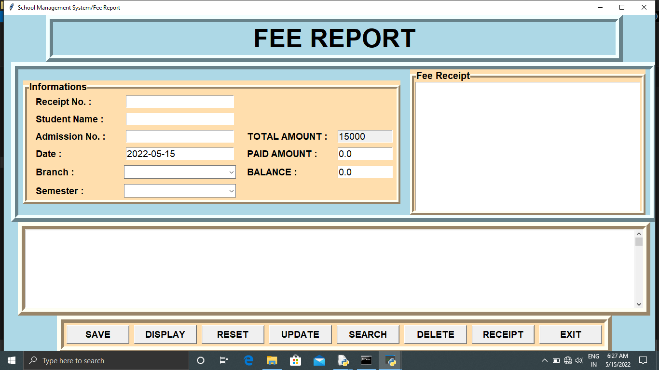
OUTPUT

Slide 12
Hardware Specification
Brand : Lenovo
Model Number : E14-25
Processor : AMD A6-7350B
RAM : 4 GB
HDD : 500 GB
Operation System : Window 10-64 Bit
Screen Size : 14 Inches

Slide 13
Software Explanation
About Python:
Python is a high-level, interpreted, interactive and object scripting language.
Python is designed to be highly readable. It uses English keywords frequently where as other languages use punctuation, and it has fewer syntactical constructions then other language.
Python is designed to be readable, and hence reusable and maintainable much more so then traditional scripting language.
In addition python has deep support for more advanced software reuse mechanisms, such as object-oriented (oo)and function programming.

Slide 14
FUTURE ENHANCEMENT
It can be implemented to upload files with an huge amount of size with the support of various file formats.
This System being web-based and an undertaking of Cyber Security Division, needs to be thoroughly tested to find out any security gaps.
A console for the data centre may be made available to allow the personnel to monitor on the sites which were cleared for hosting during a particular period.
Moreover, it is just a beginning; further the system may be utilized in various other types of auditing operation viz. Network auditing or similar process/workflow based applications...

Slide 15
Thank you…

